Slide 1
CPE 221: Computer Organization
02 Number Systems and Digital Logic
rahul.bhadani@uah.edu

Slide 2
Announcement

Slide 3
Homework 01
Due: Jan 24, 2025
Points: 100

Slide 4
Number Systems

Slide 5
Data in Modern Computing
Everything is binary.
But why?
Computers are based on transistors and switches that attain values ON and OFF. For simplicity, we translated ON to 1 and OFF to 0 or vice versa.

Slide 6
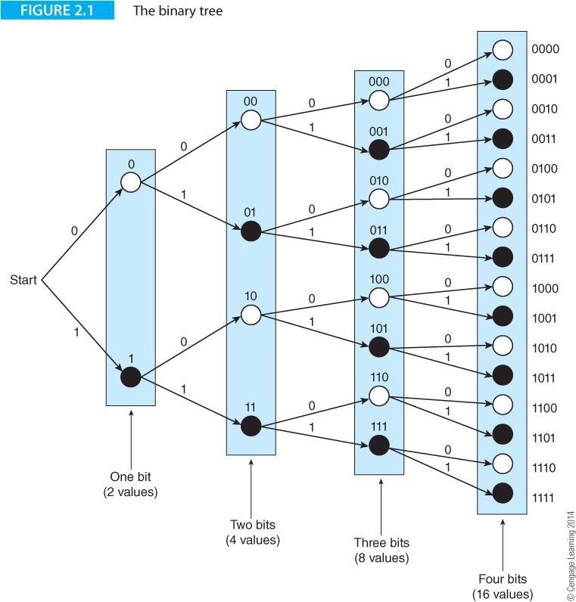
Binary, bits and bytes
The basic unit is the bit (binary digit).
A byte is 8 bits.
A word is variable length(platform to platform).
A 64-bit computer system has 64-bit words.
A 4-bit computer system has 4-bit words.
The number of values represented by an n-bit word is 2^{n}.

Slide 7
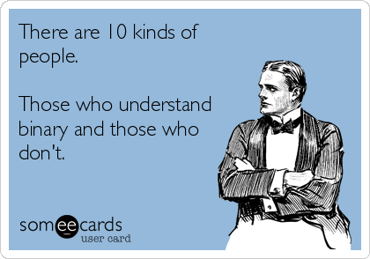

Slide 8
Data types
A collection of bits can be
Signed integer temperature
Unsigned integer attending student count
Computer Instruction plan binary to be decoded
Floating Point Number partial number values
Image jpeg,
Audio mp3, wav,
Character ascii, Unicode, UTF
Pointer (Address) Machine’s bytes counted in binary

Slide 9
Bases in Number Systems
Humans use base ten, computers use base 2.
Humans use plus or minus to indicate sign but we’re lazy so we leave off the plus sign and assume unless indicated negative.
Computers can do this as well, it’s called sign and magnitude representation but it’s rarely used.
What is used is something called signed 2’s complement representation
Positive numbers are easier, so we’ll start there
From base 6 to base 10: +1345₆ 🡪 353₁₀
Use expanded form to convert a base 6 to base 10
(1345)₆ = 1 x 6³ + 3 X 6² + 4 x 6¹ + 5 x 6⁰
(1345)₆ = (1 x 216) + (3 x 36) + (4 x 6) + (5 x 1)
(1345)₆ = (353)₁₀

Slide 10
Converting from Base 10 to Base 6
(353)₁₀ 🡪 (1345)₆
6 | 353
6 | 58 | 5
6 | 353
6 | 58 | 5
 | 9 | 4
6 | 353
6 | 58 | 5
 | 9 | 4
 | 1 | 3

Slide 11
Binary to Decimal ( Positive Unsigned)
From base 2 to base 10:
(10111000)₂ =
1x2⁷ + 0x2⁶ + 1x2⁵ + 1x2⁴ + 1x2³ + 0x2² + 0x2¹ + 0x2⁰
128 + 0 + 32 + 16 + 8 + 0 + 0 + 0
= 184

Slide 12
Binary Addition
 | 1 | 1
1 | 0 | 1 | 1
0 | 0 | 1 | 1
1 | 1 | 1 | 0

Slide 13
Signed Binary
System 1: Sign/Magnitude
N-bit binary number
Most significant bit as the sign, and remaining N-1 bits as the magnitude.
For example
(5)₁₀ = (101)₂ or (0101)₂
then (-5)₁₀ = (1101)₂
However, with this scheme, we cannot perform addition operations discussed in the previous slide. Try it out! (5)₁₀ + (-5)₁₀ = ?

Slide 14
Signed Binary
System 2: Two’s complement
To get two’s complement, write numbers in the binary, flip 0 to 1 and 1 to 0, and add 1.
Consider 00011100 which is 28 in the decimal in 8-bit binary.
Step 1: Flip the digits
11100011
Step 2: Add 1.
11100100 which is -28 in the decimal.

Slide 15
2’s complement
To convert back 2’s complement to original, basically know whose number it is negative of
Step 1: Flip 0 and 1.
Step 2: Add 1
11100100 ⇒ 00011011⇒ 00011100

Slide 16
Arithmetic with Two's Complement
With two’s complement, circuitry for addition and subtraction can be unified as we will see later.
Add 12 and 21
00001100
00010101
—------------
00100001
Add 12 and -21
-21 is
00010101 ⇒ 11101010 ⇒11101011
00001100
11101011
—------------
11110111 which is (-9) in two’s complement

Slide 17
Two's Complement
In 2’s complement, the most significant bit tells you whether the number is positive or negative.
Range -2^(n-1) to +2^(n-1) - 1. if n=8 then range is -128 to +127. (n is the bit count)*
Two’s complement facilitate same hardware
* Bit count of an integer is typically 32 (4 bytes) in most systems
Notes:
https://www.cs.cornell.edu/~tomf/notes/cps104/twoscomp.html

Slide 18
Decimal and Fractional Number Representation

Slide 19
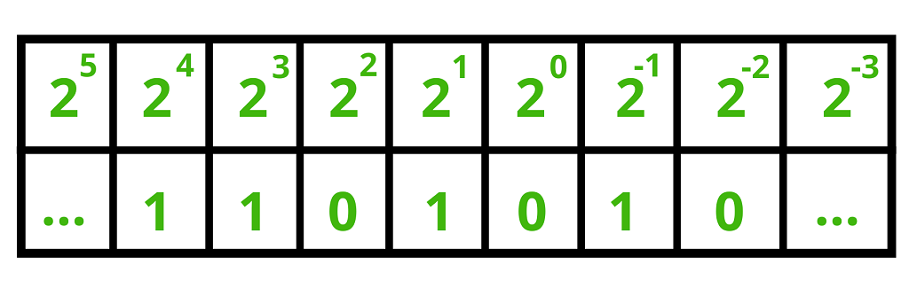
Fixed-points numbers
26.5
26 = high word
.5 = low word
2 * 10¹ + 6 * 10⁰ + 5 * 10⁻¹ = 26.5
11010.1₂
= 1 * 2⁴ + 1 * 2³ + 0 * 2² + 1 * 2¹ + 0* 2⁰ + 1 * 2⁻¹
= 16 + 8 + 2 + 0.5
= 26.5

Slide 20
Fixed Point representation of negative number
Consider the number -2.5, fixed<w,b> width = 4 bit, binary point = 1 bit (assume the binary point is at position 1). First, represent 2.5 in binary, then find its 2’s complement and you will get the binary fixed-point representation of -2.5.
2.5 ₁₀ = 0101 ₂
-2.5 ₁₀ = 1010 ₂ + 1 (1’s complement + 1 = 2’s complement)
-2.5 ₁₀ = 1011 ₂

Slide 21
Floating-point Number Representation
IEEE 754 Floating-point standard (1985)
https://standards.ieee.org/ieee/754/6210/
https://ieeexplore.ieee.org/stamp/stamp.jsp?tp=&arnumber=8766229
Consider
4.1 x 2³
exponent
sign
mantissa

Slide 22
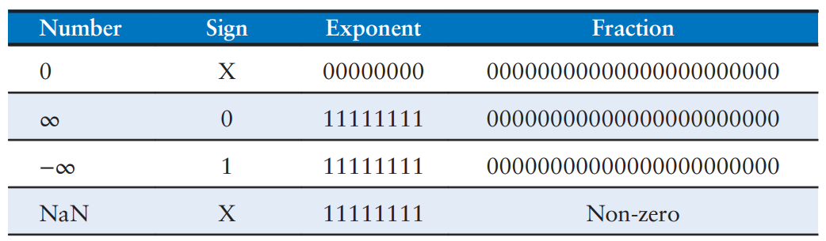
Rules for IEEE 754 Floating-point standard
32 bits = 1 bit for sign + 8 bit for exponents + 23 bits for mantissa.
64 bits = 1 bit for sign + 11 bit for exponents + 52 bits for mantissa.
In binary representation, the first bit of the mantissa is always 1 (excluded from 23 (or 52) bits).
Floating point representation uses bias. That is actual floating point + a constant bias. For a 32 bit floating point, the bias is 127. Hence the exponent of 7 is written as 7 + 127= 134 = 10000110₂.
Special case

Slide 23
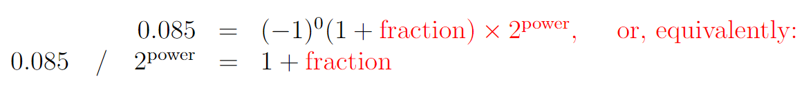
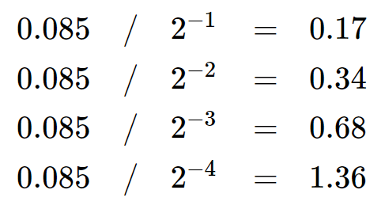
Example
0.085 in Single precision (32 bit) binary format
We write 0.085 in base-2 scientific notation, that is we must factor it into a number in the range (1≤n<2) and a power of 2.

Slide 24
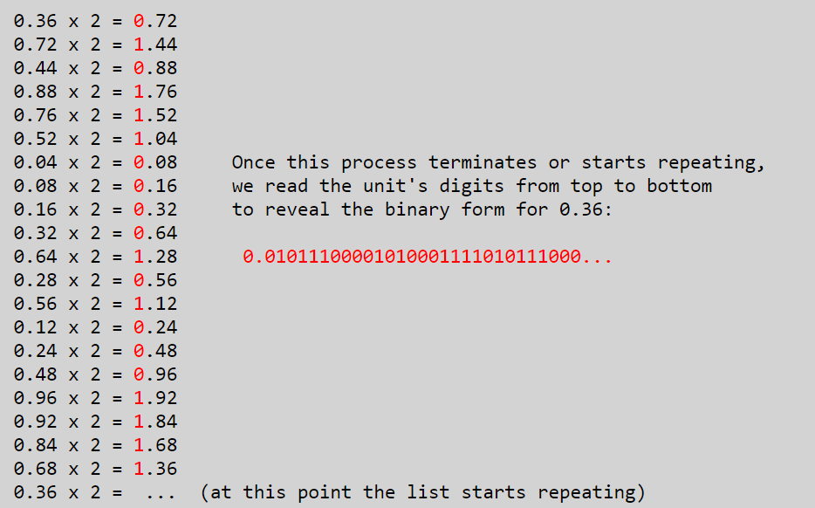
Example …
Therefore, 0.085=1.36×2⁻⁴
Now, we find the exponent
exponent = −4+127=123=01111011₂
Then, we write the fraction in binary form using successive multiplications by 2
But we only have 23 bits.
0.01011100001010001111011
So 0.085 in IEEE 754 format is:
0 01111011 01011100001010001111011

Slide 25
Data Formats

Slide 26
Some Common Data Representation
Types of Data | Standard(s)
Alphanumeric | Unicode, ASCII
Image (bitmap) | GIF, TIFF, PNG, JPEG
Image (object) | Postscript, SVG
Outline graphics and Fonts | Postscript, TrueType
Page Description | PDF, HTML, XML
Video | MPEG-4, WMV, MP4

Slide 27
Alphanumeric Codes
ASCII (American Standard Code for Information Interchange)
Unicode
EBCDIC (Extended Binary Coded Decimal Interchange Code): Defunct
ASCII and EBCDIC both can be stored using 1 byte. (How many bits in one byte?) Hence, ASCII is limited in what it can represent.

Slide 28
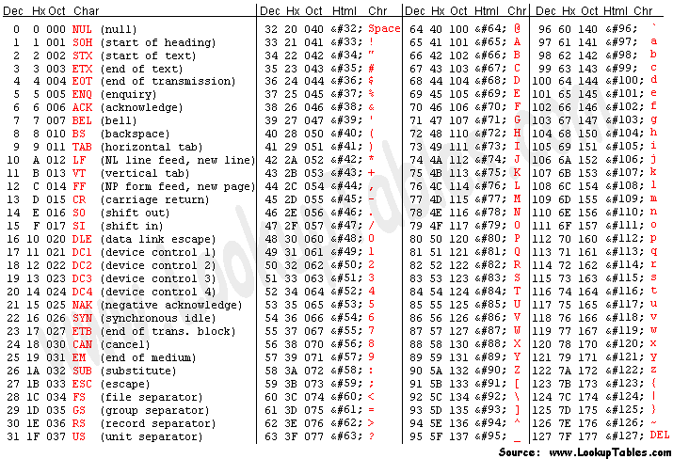
ASCII Table
https://www.asciitable.com/

Slide 29

Unicode
https://home.unicode.org

Slide 30
Unicode
Most common Unicode is UTF(Unicode Transformation Format)-16: uses 16 bits (how many characters it can represent?)
Unicode is multilingual: has representation for other languages, and emojis.
Each UTF-16 alphanumeric character is stored using two bytes

Slide 31
Computer Logic

Slide 32
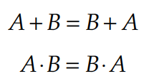
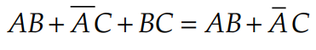
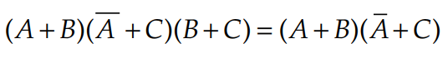
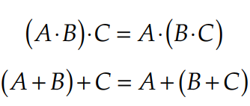
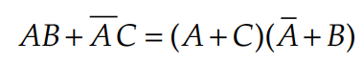
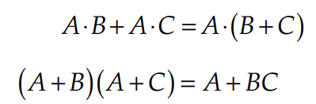
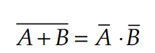
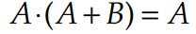
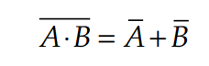
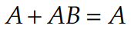
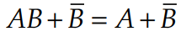
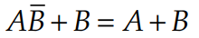
Boolean Algebra: A Quick Cheatsheet (otherwise see in your EE 202)
Law of Commutation
Law of association
Law of Distribution
Law of absorption
Consensus theorem
Transposition theorem
De Morgan’s theorem-I
De Morgan’s theorem-II

Slide 33
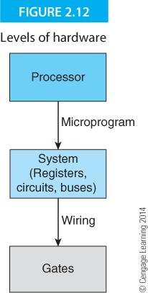
Computer Logic using Logic Gates (1)
Computers are constructed from two basic circuit elements
Combinational logic elements (gates)
Sequential logic elements ( flip-flops)
A combinational logic element is a circuit whose output depends only on its current inputs.
A sequential element is a circuit whose output depends on present inputs and past inputs (captured as the state of the element or a form of memory).
Sequential elements themselves can be made from simple combinational logic elements.

Slide 34
Computer Logic using Logic Gates (2)
Any combinational circuit can be made from AND , OR , and NOT gates.
This set of gates is said to be functionally complete.
Because flip-flops can be constructed from gates, all computers can be constructed from gates alone.
Moreover, because the NAND or NOR gate, can be used to synthesize AND, OR, and NOT gates, any computer can be constructed from nothing more than a large number of NAND or NOR gates.

Slide 35
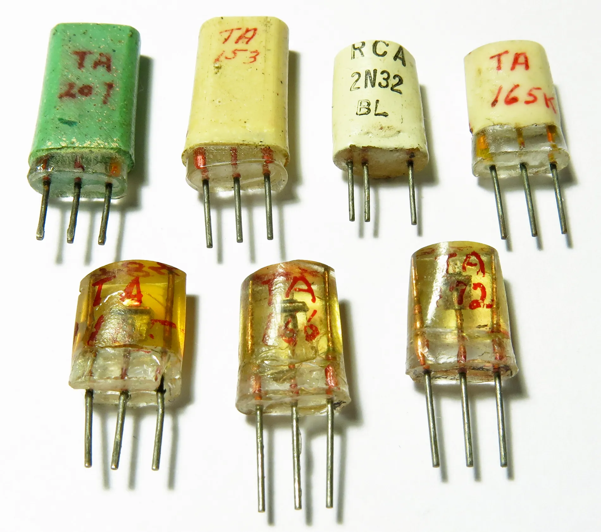
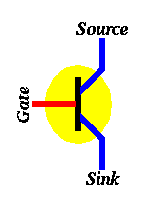
Why Logic Gates are called Logic Gates
The word “logic” implies decision making. The word “gate” is used in electronics to describe a switch, in the early days of logic a switch comprised discrete transistors. The gate switches the “output” of a “decision” based on the type of gate and the information provided to the gates “input”.
HOW THE FIRST TRANSISTOR WORKED

Slide 36
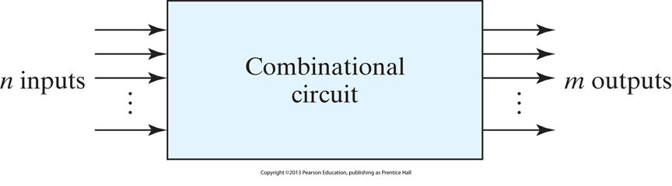
Computer Logic Diagram
Combinational logic – This is a abstract level view of a computer architecture. EE’s will have classes that study the layers underneath, including the transistor.

Slide 37
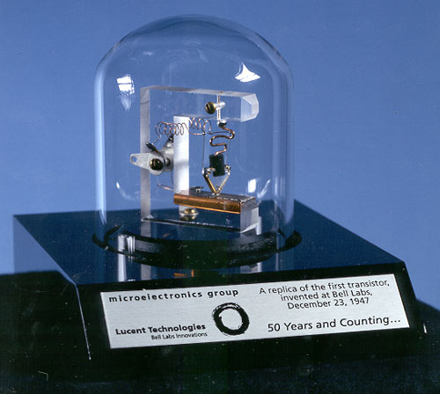
Transistor
“Trans Resistor” invented in 1947 in Bell Laboratories, replaced the vacuum tube triode
Probably the single most important invention to computer and electrical science.
Works by manipulating resistances
Optional videos in canvas

Slide 38
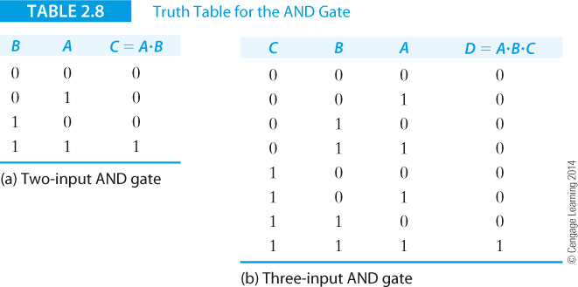
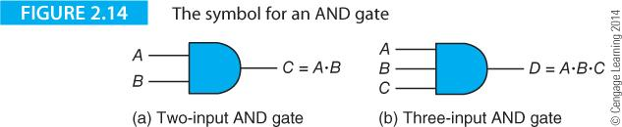
AND Gate

Slide 39
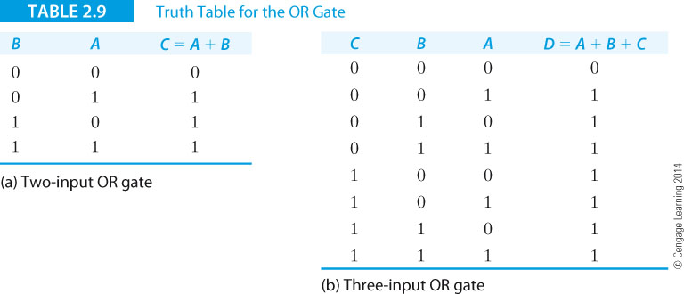
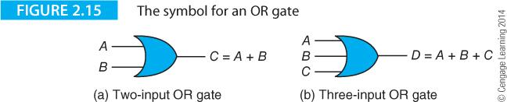
OR Gate

Slide 40
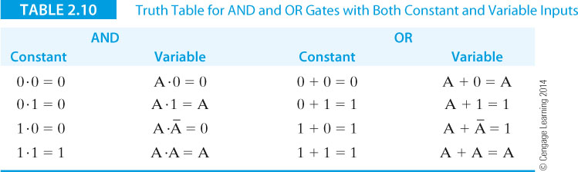
Comparing AND and OR Gates

Slide 41
Points to Note
Setting one input of an AND to constant 0 PERMANENTLY disables that gate (until that input is allowed to be 1 again), setting its output to constant 0
Setting one input of an OR gate to constant 1 also permanently disables it, but its output is constant 1

Slide 42
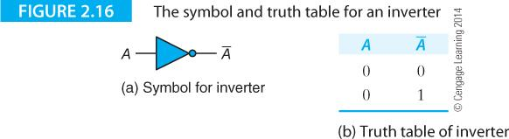
Inverter or NOT Gate

Slide 43
Question
Which logic statement(s) below is true?
B OR B’ = 1
B AND B’ = 0
A OR 1 = 0

Slide 44
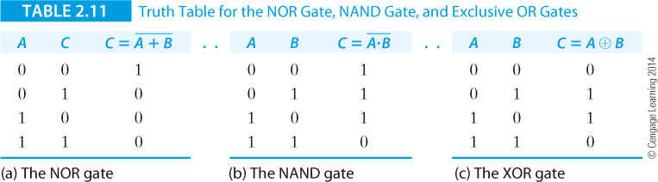
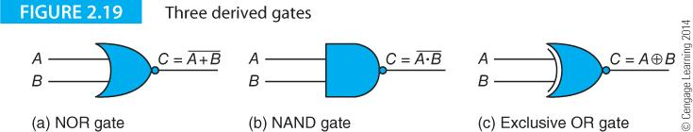
NOR, NAND, Exclusive OR (XOR)

Slide 45
Question
What is the output of A NAND B when A = 1 and B = 1? If A = 1 and B = 0?

Slide 46
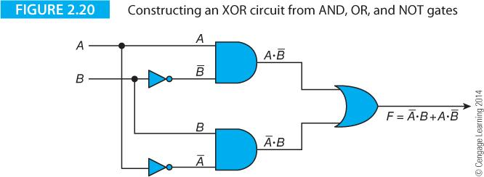
Making XOR out of AND, OR, NOT

Slide 47
Combination Circuits

Slide 48
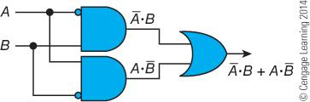
Inversion Bubbles

Slide 49
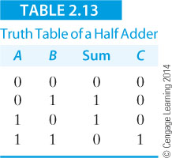
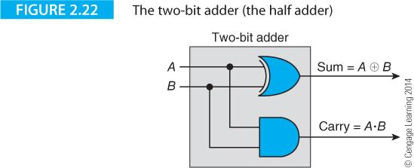
The Half Adder

Slide 50
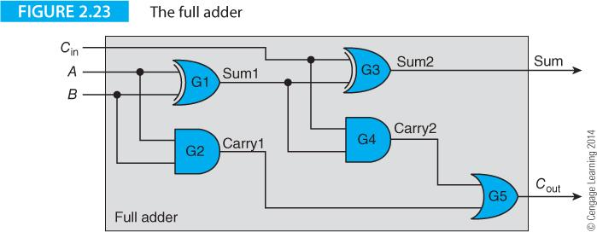
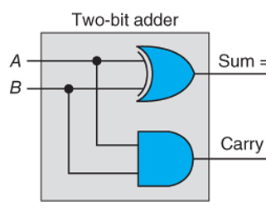
The Full Adder
Half adder here
Cin | A | B | Sum | Cout
0 | 0 | 0 | 0 | 0
0 | 0 | 1 | 1 | 0
0 | 1 | 0 | 1 | 0
0 | 1 | 1 | 0 | 1
1 | 0 | 0 | 1 | 0
1 | 0 | 1 | 0 | 1
1 | 1 | 0 | 0 | 1
1 | 1 | 1 | 1 | 1

Slide 51
Question
A full adder has inputs A, B, and Cin with the values of (1,1,0). What are the output values for Cout and S?
A full adder has inputs A, B, and Cin with the values of (1,1,1). What are the output values for Cout and S?

Slide 52
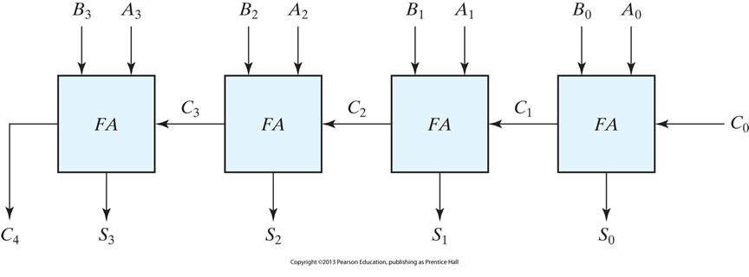
Ripple Carry Adder

Slide 53
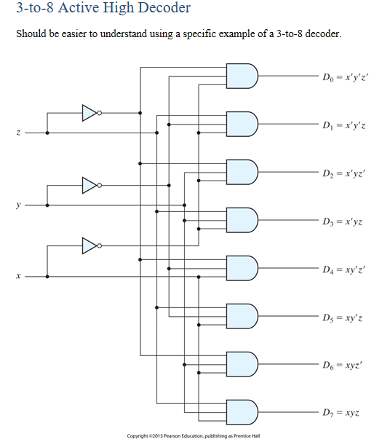
Decoding an Instruction

Slide 54
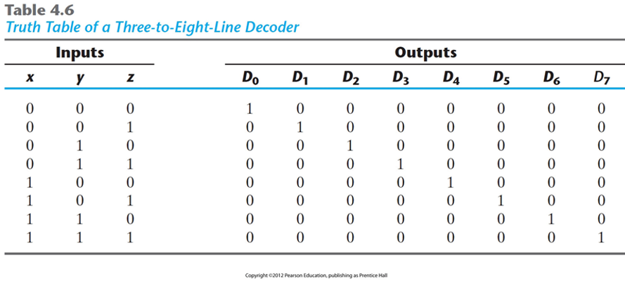
Decoder Truth Table

Slide 55
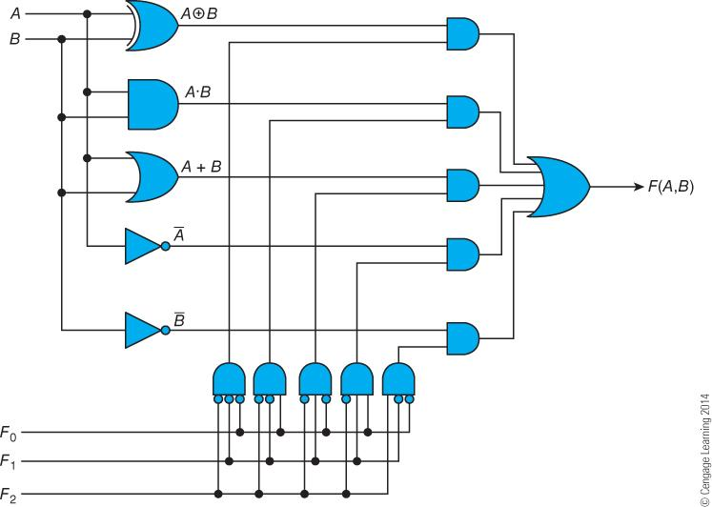
One Bit of an ALU (Arithmetic Logical Unit)

Slide 56
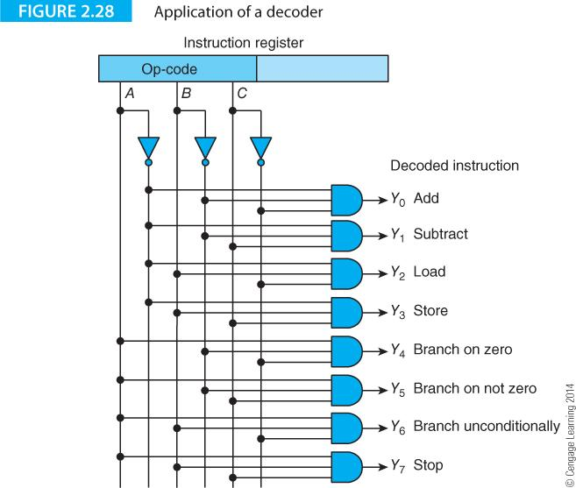
Decoding an Instruction

Slide 57
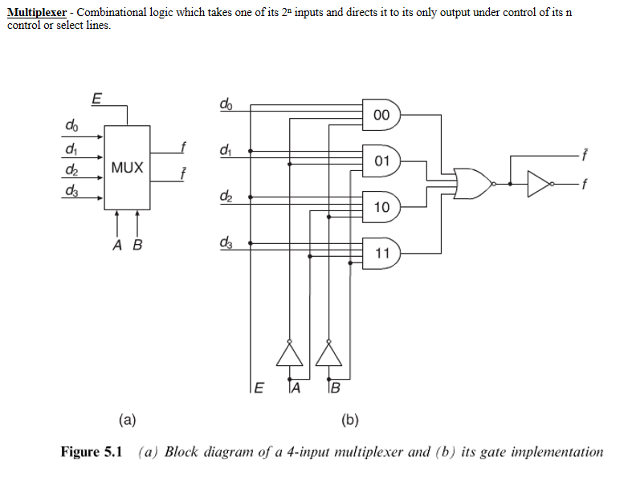
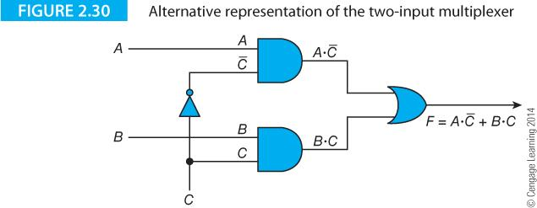
Multiplexer

Slide 58
Circuit Simplification

Slide 59
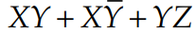
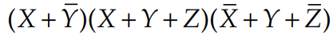
Sum of Products and Product of Sums
Sum-of-products (SOP): A SOP is the logical OR operation of multiple product terms. Each product term is the logical AND operation of binary literals. For example,
is a SOP expression.
Product-of-sum (POS): A POS is the logical AND operation of multiple ORrd terms. Each sum term is the logical OR operation of binary literals. For example,
is a POS expression.

Slide 60
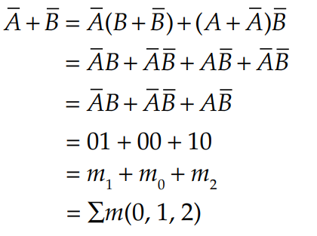
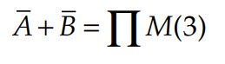
Minterm and Maxterm
Minterm: A minterm is a special case product (AND) term. A minterm is a product term that contains all of the input variables (each literal no more than once) that makes up a Boolean expression. Example:
XYZ for a three input logic circuit. Denoted by small m.
Maxterm: A maxterm is a special case sum (OR) term. A maxterm is a sum term that contains all of the input variables (each literal no more than once) that make up a Boolean expression. Example:
X + Y + Z for a three input logic circuit. Denoted by capital M.
Sum of products
Product of Sum

Slide 61

Karnaugh Map for Circuit Simplification
Two-variable K-map using minterms

Slide 62

Two-variable K-map using maxterms

Slide 63


Three-variable K-map

Slide 64


Four Variable K-map

Slide 65


Q1: Simplify f(x,y,z, ) = ∑m(0, 1, 2, 3) using Karnaugh Map

Slide 66
Q2. Simplify f( x, y, z) = ∑m(2, 3, 5, 7) using Karnaugh Map

Slide 67

Multiplexers: Minimizing a Circuit
They choose an output from several possible inputs based on the value of select signal.
if S = 0
Y = D0
if S = 1
Y = D1
S
D0
Y
D1

Slide 68
Sequential Circuits

Slide 69

Sequential Circuits from Combination Circuits

Slide 70

Clock

Slide 71


Latch
A latch is a combinational (asynchronous) circuit that uses present states to dictate future states. “Memory” is created.

Slide 72


SR Latch
The simplest latch is the Set-Reset (S-R) latch. You can build one by connecting two NOR gates with a cross-feedback loop.
S = 1 and R = 0 | Q' = 0 and Q = 1 (set)
S = 0 and R = 0 | Q' = 0 and Q = 1 still (no change)
S = 0 and R = 1 | Q = 0 and Q' = 1 (reset)
S = 0 and R = 0 | Q = 0 and Q' = 1 still (no change)
S = 1 and R = 1 | Q' = 0 and Q = 0 (illegal state)

Slide 73

Circuit for SR Latch
You can build an SR latch using the CD4001 chip.
The CD4001 is a CMOS chip with four NOR gates.
When the button PB2 is pushed, the LED L2 turns on and stays on even after PB2 is released, while the LED L1 remains off. LED L2 turns off when the button PB1 is pressed, whereas LED L1 turns and stays on even after PB1 has been released. To assemble the above circuit you need:
The CD4001 chip
Two push buttons (PB1 and PB2)
Two LEDs
Two 10 kΩ resistors (R1 and R2)
Two 330 Ω resistors (R3 and R4)

Slide 74


D-Latch
A D Latch is a logic circuit that can store one bit of data (1 or 0).
The D Latch has two inputs: D (Data) and E (Enable).
The latch will only change its output (Q) when the Enable input is HIGH. If E is HIGH, the output Q will reflect the value of the D input. If E is LOW, the output will remain the same, regardless of the D input.
The D Latch avoids the “undefined” or “invalid” state problem found in the S-R latch. This is because the inverter at the input of the D Latch makes sure the S and R inputs are always opposites.
Function
When CLK = 1
D passes through to Q (transparent)
When CLK = 0
Q holds its previous value (opaque)
Avoids invalid case when Q ≠ NOT Q

Slide 75

D-Latch Circuit
1: Q is 0 (LED L1 off), and both PB1 and PB2 are not pressed.
2: PB2 is pushed. You now have a 1 on the D input, but the output Q remains as 0 because the E input hasn’t received an enable signal yet.
3: When PB1 is pressed, a 1 on the E input appears and places the bit 1 from D to Q. When Q is 1 it turns on LED L1.
4: PB1 and PB2 return to their original states in section 4, LED L1 remains ON indicating that the Q output has not changed.
To assemble the above circuit you need:
Four NAND gates (Ex CD4011)
One NOT gate (Ex CD4049 or CD4069)
2x pushbuttons
1x LED
2x 10 kΩ resistors (R1 and R2)
1x 330 Ω resistors (R3)

Slide 76


D-Latch
Two inputs: CLK, D
CLK: controls when the output changes
D (the data input): controls what the output changes to
Fixes Issues with SR Latch when both S and R are asserted.
Function
When CLK = 1
D passes through to Q (transparent)
When CLK = 0
Q holds its previous value (opaque)
Avoids invalid case when Q ≠ NOT Q

Slide 77

Practice with a D Latch

Slide 78
Flip Flops
A latch can change its output at any time as long as it’s enabled, a flip flop is an edge-triggered device that needs a clock transition to change its output.

Slide 79

SR Flip Flop

Slide 80


The D Flip-Flop

Slide 81
Practice with a D Flip-Flop

Slide 82

Timing in Sequential Circuits

Slide 83

Timing in Sequential Circuits (Pipelining)

Slide 84

Registers
The register is an m-bit storage element that uses m flip-flops to store an m-bit word. The clock inputs of the flip-flops are connected together and all flip-flops are clocked together.

Slide 85

A Shift Register
This shift register shifts right only. A shift register can be designed to shift left only, to be capable of shifting left or right, and to have parallel load. Shifting is useful to multiply or divide by powers of 2. It can also be used to look at individual bits of the contents of a register so that decisions can be made based on their value.

Slide 86

Other Shift operations
Shift type |  | Shift Left |  | Shift Right
Original bit pattern before shift |  | 1101 0111 |  | 1101 0111
Logical shift |  | 1010 1110 |  | 0110 1011
Arithmetic shift |  | 1010 1110 |  | 1110 1011
Circular shift |  | 1010 1111 |  | 1110 1011

Slide 87

Parallel Load Capacity

Slide 88

Serial Input/ Serial Output

Slide 89

Serial Adder

Slide 90

Tristate Gates

Slide 91

Tristate Buffers

Slide 92

Buses and Tristate Gates
When we connect multiple drivers to a bus, we need a way for only one of them to drive the bus at a time. One way to do this is tristate gates with enable inputs that come from the output of a decoder so that only one tristate is enabled at a time.

Slide 93

Registers, Buses and Functional Units
E0 - E3 would come from a decoder

Slide 94

Implementing a MOVE (Copy) Instruction

Slide 95

Multiple Buses and an ALU

Slide 96
Video of the day
The History of the Integrated Circuit
https://www.youtube.com/watch?v=SYSJefKc7L4

